Slide 1
Lecture 3
Modeling and Documenting Requirements
Heim, Chapters 4.3 - 4.4
and Dix et al, Chapter 15

Slide 2
Modeling and documenting
By the end of this lecture you will be able to describe each of the following.
Task Analysis
  Hierarchical task analysis (HTA)
  State transition networks (STNs)
    Assignment 1 Requirement
Storyboarding
Use Cases

Slide 3
Interpretation - Task Analysis
Task analysis is a way of documenting how people perform tasks
A task analysis includes all aspects of the work flow
It is used to explore the requirements of the proposed system and structure the results of the data collection phase or document an existing system

Slide 4
Interpretation - Task Analysis
Hierarchical task analysis (HTA)
  HTA provides a top-down, structured approach to documenting processes.
State transition network (STN)
  Provides a description what actions/events are available at what point and what state the system will be in after each action

Slide 5
HTA decomposition elements
Goal – top-level goal of the task being analysed
Plans – the order and conditions for proceeding with the sub-tasks
Information – all the information needed to undertake the task
Objects – all the physical objects involved
Methods – the various ways of doing the sub-tasks

Slide 6
Textual HTA description (from Dix et al.)
Note this section of Dix is on the Piazza pages for the course
Hierarchy description ...
0. in order to clean the house
1. get the vacuum cleaner out
2. get the appropriate attachment
3. clean the rooms
3.1. clean the hall
3.2. clean the living rooms
3.3. clean the bedrooms
4. empty the dust bag
5. put vacuum cleaner and attachments away
... and plans
Plan 0: do 1 - 2 - 3 - 5 in that order. when the dust bag gets full do 4
Plan 3: do any of 3.1, 3.2 or 3.3 in any order depending
on which rooms need cleaning
N.B. only the plans denote order or selection (ifs)

Slide 7
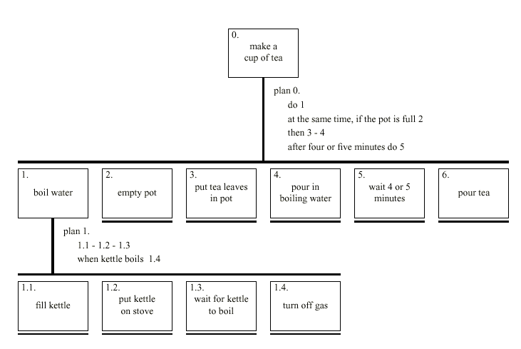
Diagrammatic HTA (from Dix et al.)
Note this section of Dix is on Piazza

Slide 8
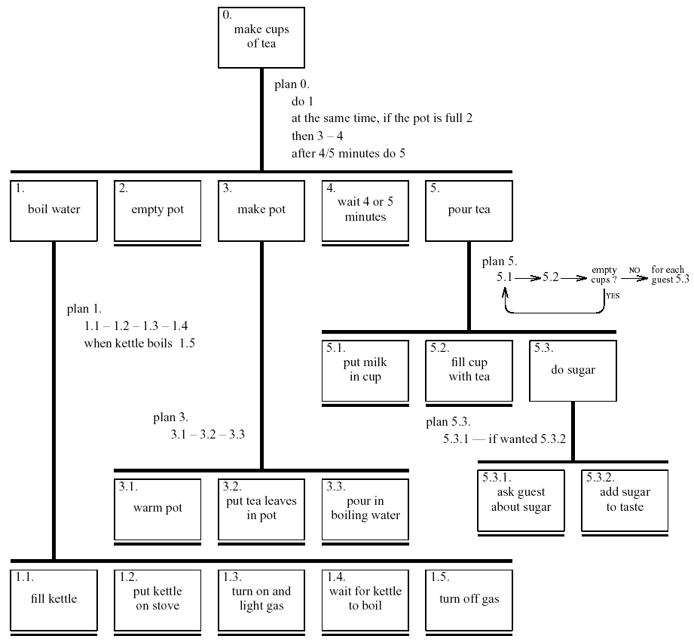
Refined HTA for making tea

Slide 9
Types of plan
fixed sequence - 1.1 then 1.2 then 1.3
optional tasks - if the pot is full 2
wait for events - when kettle boils 1.4
cycles - do 5.1 5.2 while there are still empty cups
time-sharing - do 1; at the same time ...
discretionary - do any of 3.1, 3.2 or 3.3 in any order
mixtures - most plans involve several of the above

Slide 10
Diagram Notation
Element to be decomposed
Bottom of the hierarchy denoted by underline
Notice – no vertical line here
Different style of plan
Plans sits beside vertical
Numbering 1 – 1.1 – 1.1.1 ….

Slide 11
State transition networks (STN)
circles - states
arcs - actions/events

Slide 12
State transition networks - events
arc labels a bit cramped because:
  notation is ‘state heavy’
  the events require most detail

Slide 13
State transition networks - states
labels in circles a bit uninformative:
  Sometimes states are hard to name (but do try)
  but easier to visualise

Slide 14
Hierarchical STNs
managing complex dialogues
named sub-dialogues
Graphics Submenu
select ‘graphics’
Main
Menu
select ‘text’
Text Submenu
Paint Submenu
select ‘paint’

Slide 15
Concurrent dialogues - I simple dialogue box
Text Style
bold
example
italic
underline

Slide 16
Concurrent dialogues - II three toggles - individual STNs
NO
bold
click on ‘bold’
bold
bold
NO
italic
click on ‘italic’
italic
italic
NO
u’line
click on ‘underline’
u’line
underline

Slide 17
Concurrent dialogues - III bold and italic combined
Text Style
bold
NO
style
click on ‘bold’
bold
only
example
italic
underline
click
on
‘italic’
click
on
‘italic’
italic
only
click on ‘bold’
bold
italic

Slide 18
Concurrent dialogues - IV all together - combinatorial explosion
Text Style
NO
style
‘bold’
bold
only
bold
example
italic
‘underline’
‘underline’
underline
‘italic’
‘italic’
u’line
only
‘bold’
bold
u’line
‘italic’
‘italic’
italic
only
‘bold’
bold
italic
‘underline’
‘underline’
italic
u’line
‘bold’
bold
italic
u’line

Slide 19
escapes
‘back’ in web, escape/cancel keys
  similar behaviour everywhere
  end up with spaghetti of identical behaviours
try to avoid this
e.g. on high level diagram
‘normal’ exit for
each submenu
plus separate
escape arc active
‘everywhere’ in submenu
Graphics Submenu
ESC
select ‘graphics’
normal
finish
Main
Menu
select ‘text’
Text Submenu
ESC
normal
finish
Paint Submenu
ESC
select ‘paint’
normal
finish

Slide 20
help menus
similar problems
  nearly the same everywhere
  but return to same point in dialogue
  could specify on STN … but very messy
  usually best added at a ‘meta’ level
Circle 1
click on centre
Circle 2
click on circumference
Finish
from
Menu
rubber band
draw circle
press HELP
button
press HELP
button
Help Subsystem
Help Subsystem

Slide 21
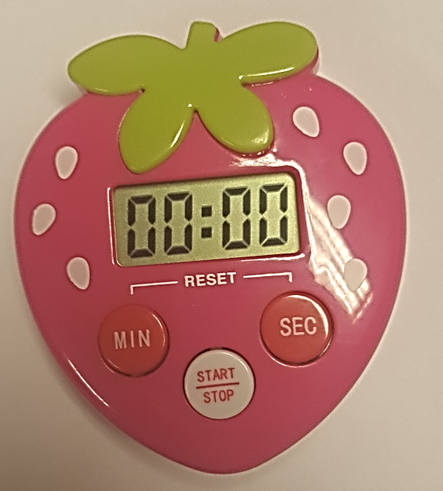
Example
3 Button Timer
Min
Sec
Stop/Start
Process
Pressing the min or sec increments the appropriate section of the display
Pressing the min and sec together resets the timer
Pressing the stop/start
  When the display is 00:00 starts a count up (display updates each second)
  When the display is not 00:00 starts a count down (updates each second)
    When stop/start pressed, count-down suspended
    When the time == 0 alarm sounds
      When stop/start pressed
        Alarm stops
        Time reset to starting value

Slide 22
Solution
Worked in class

Slide 23
Solution 2

Slide 24
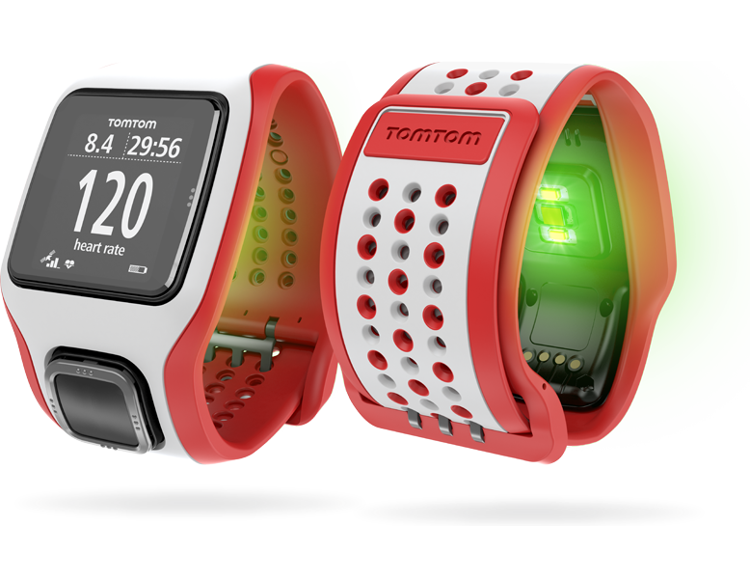
When to use?
Small discrete systems or subsystems
  Shopping basket
  Smart watch
  Internet of things

Slide 25
Interpretation - Storyboarding
Storyboarding involves using a series of pictures that describes a particular process or work flow
  Can be used to study existing work flows or generate requirements.
  Can facilitate the process of task decomposition
  Used to brainstorm alternative ways of completing tasks.

Slide 26
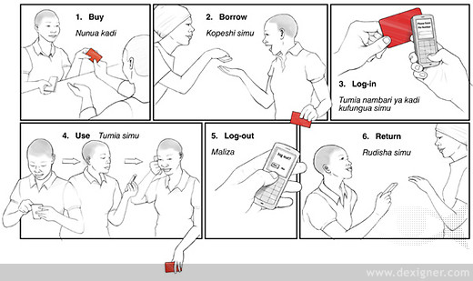
Storyboard
Example of a method for people who don’t own a cell phone handset to buy access for voice, SMS, etc. - http://www.dexigner.com/news/20788

Slide 27
Interpretation – Use Cases
Use cases represent a formal, structured approach to interpreting work flows and processes
  Designed to describe a particular goal and explore the interaction between users and the actual system components.
Jacobson et al. (1992)
Incorporated into the Unified Modeling Language (UML) standard.

Slide 28
Interpretation – Use Cases
The two main components of use cases are the actors and the use cases that represent their goals and tasks.
  Actors: similar to stakeholders, but can also include other systems, networks, or software that interacts with the proposed system.
  Use Cases: Each actor has a unique use case, which involves a task or goal the actor is engaged in.
    Describe discrete goals that are accomplished in a short time period
    Describe the various ways the system will be used and cover all of the potential functionality being built into the design

Slide 29
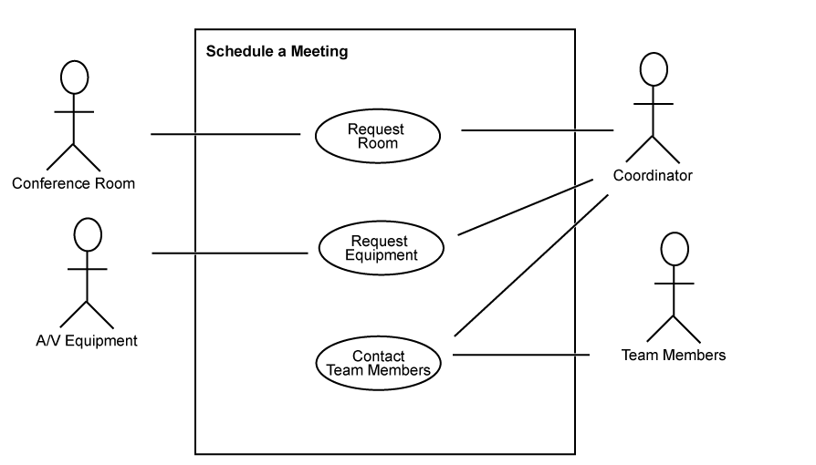
Interpretation – Use Cases
Notice we use a stickman symbol for the equipment!
Use case diagram of “schedule a meeting” process.

Slide 30
Use cases
The diagram provides an overview of the entities and their relationships through activities
This can be used to develop and explore scenarios
  Basic path – the steps proceed without diversions from error conditions
  Alternative paths – branches related to premature termination, choosing a different method of accomplishing a task, etc.
    E.g., what if the equipment isn’t available?

Slide 31
Documentation
Collating all the data and intermediate documents from the Discovery Phase
Working documents include
  Human centred
    interviews, focus groups, surveys, primary stakeholder profiles
  System centred
    task analysis, use case diagramming
Collate into
  Mission statement
  Requirements document
  Project management document
  Usability guidelines

Slide 32
Documentation
Mission Statement
  Project goals:
    What is the value proposition?
    What needs will the new system address?
    How will it address these needs?
  Project scope
    What does the proposed design include or exclude?
    What are the external constraints such as time and finances?
    How will you decide when it satisfies the design proposal?

Slide 33
Documentation
Requirements Document
  Requirements
    Functional – what features must be present?
    Information – what information is needed to carry out the functions? And what outputs are required by the stakeholders?
    Physical – what’s it run on? And where will it be used? (may need to accommodate organisation’s ‘legacy’ systems).
  Inputs/outputs – data format / translation issues?
  Constraints – physical, financial, time, data storage, networking, etc.

Slide 34
Documentation
Project Management Document
  Definition of the tasks involved in the project
  Risk – what could go wrong?
  Evaluation criteria and methods – what will constitute ‘success’?
  Implementation – e.g. phased in one department at a time
  Training
  Maintenance
  Future needs – anticipated requirements beyond the bounds of the ‘project’ per se

Slide 35
Summary
Crucial to identify all stakeholders in a project
Utilize a wide range of collection techniques to understand the needs of a project
Task analysis, storyboarding and use case techniques allow for interpretation of collated data

